Slide 1
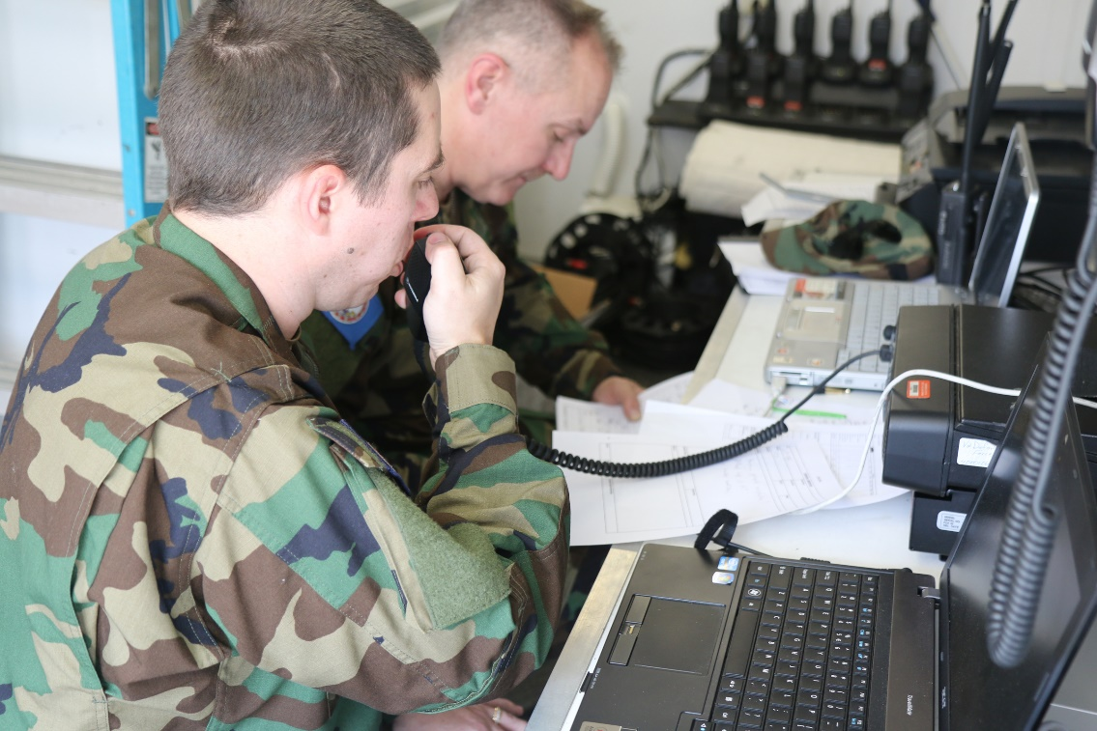
VIRGINIA DEFENSE FORCE COM 100: Basic Communications

Slide 2
COM 100 Purpose
Action: Discuss basic VDF communication practices
Conditions: Interactive classroom
Standard: Be able to understand the basics of VDF communication and the role of communications in operations
*SILENCE CELLPHONES
*50/10 TIMEKEEPER
*SIGN IN FOR CREDIT
*TESTABLE
*SAFETY BRIEF
Notes:
Safety brief: Exits, weather notes/hydration/report illness immediately/report return home to COC if leaving after class

Slide 3
Course Objectives
At the completion of this period of instruction, you should be familiar with the following:
Explain basic communication mission and operational procedures, radio-telephone practices, and message documentation procedures
Recognize how to operate Statewide Agencies Radio System (STARS) Radio and Organic VDF Handheld Radio(s)
Recite the Phonetic Alphabet and other pertinent terminology
Understand safety precautions associated with communication duties

Slide 4
Mission

Slide 5
VDF COM Mission
Introduction
An emergency communicator must do his or her part to get every message to its intended recipient, quickly, accurately, and efficiently.
Several factors can affect your ability to do this, including your own operating skills, the communication method used, a variety of noise problems, the skills of the receiving party, the cooperation of others, and adequate resources.
In an emergency, any given message can have huge and often unintended consequences. An unclear message, or one that is modified, delayed, misdelivered, or never delivered at all can have disastrous results.

Slide 6
VDF COM Mission
Mission
The TAG has directed that VDF provide security and civil support capabilities per the references and specifically as outlined in the NGCS Playbook. VDF will develop civil support competencies to support related missions assigned by the JFHQ.

Slide 7
VDF COM Mission
Mission Essential Task List (METL).
(1) Provide the VDF COM Level 1-qualified Soldiers.
(2) Ensure Soldiers are properly trained to applicable NGCS Playbook COMM missions and prepared for assignment to a National Guard Support Team (NGST) per the references.
(3) Maintain information on VDF expert personnel qualified in select specialties listed in COM Level 2, as described below, in order to augment the VANG capabilities.
(4) Train to proficiency for protecting people and property across the Commonwealth of Virginia during man-made and natural disasters.

Slide 8
VDF COM Mission
General Communications Support. The TAG has directed that VDF further provide general Communications capabilities as outlined in the NGCS Playbook to support the VANG, including:
(1) STARS Radios
(2) Provide IMAR Teams.*
(3) Provide HFRR Teams.*
(4) Provide MCP Resource Teams.*
(5) HF Teams supporting the VDEM and JOC Radio Rooms;
(6) Joint Incident Site Communications Capability (JISCC) system support
*These Teams can be combined and a hand-held STARS radio added for more robust support.

Slide 9
Radio & Equipment

Slide 10
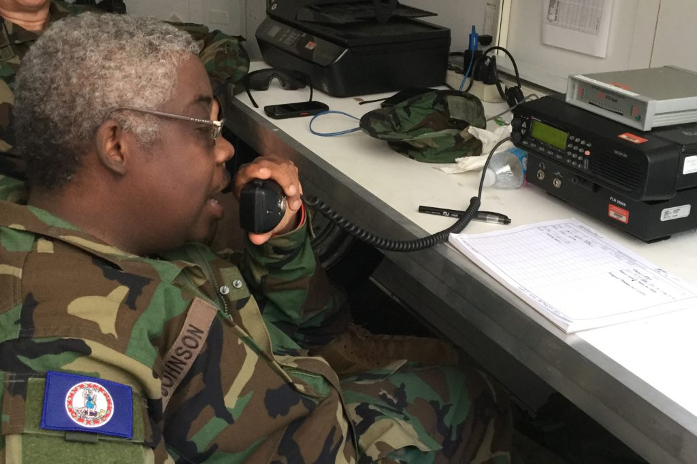
Radio & Equipment

Slide 11
Radio & Equipment
ICOM IC700

Slide 12
Radio & Equipment
TACPAK
Overview of TACPAK
Inventory
Power Management
Computer WLAN and WiFi
Printer / Scanner
GPS / Video / Camera
Telephony: Terr. & Sat.
Skype and PolyCom

Slide 13
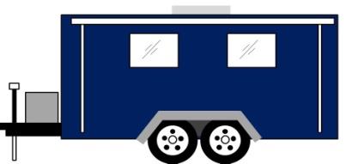
MOBILE COMMUNICATION PLATFORM RESOURCE (MCPR)
CAPABILITY: Establish communication links required for Force Packages Communication with JTF/JEOC /VEOC for tasking needs and mission status Capable of stand alone operations for 72 hours Provide ground to air communications as required |  | TIME STANDARDS: Muster: 12 hours Deploy: 14 hours | TYPE STANDARDS: Military: Team NIMS Type: Strike Team
COMPONENTS: 1 x WO (OIC) 1 X E-6/E-7 (NCOIC, Operator) 3 x E-4/E-6 (Operators) 2 x E-4/E-6 (Drivers/Security/Operator) 1 x 4 X 4 Heavy Duty Vehicle w/radio 1 x 25 Ft enclosed self-contained HF/VHF, communications trailer with on-board generator 1 x SAD Cell phone 1 x TAC PAK 1 x STARS Handheld radio |  |  | COMMUNICATIONS: P: SAD Cell A: Email C: STARS E: HF
Total PAX: 7
MOBILE COMMUNICATION PLATFORM STRIKE TEAM (MCPR)
C-7-13
Notes:
FEMA (8805), Truck, Pickup 1¾ ton, $30/hour

Slide 14
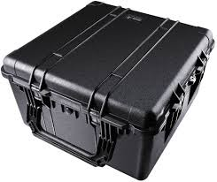
INCIDENT MANAGEMENT ASSISTANCE RESOURCE (IMAR)
CAPABILITY: Provide communications assistance to deployed elements as directed |  | TIME STANDARDS: Muster: 12 hours Deploy: 14 hours | TYPE STANDARDS: Military: Team NIMS Type: Single Resource
COMPONENTS: 1 x O1-03 or WO1-WO4 (OIC) 2 x E3-E6 (Comms) 1 x SAD Cell Phone 1 x TAC PAK 1 x STARS handheld Radio |  |  | COMMUNICATIONS: P: E-Mail A: SAD Cell Phone C: STARS Radio E:
Total PAX: 3
INCIDENT MANAGEMENT ASSISTANCE RESOURCE (IMAR)
C-7-14

Slide 15
STATE AGENCIES RADIO SYSTEM RESOURCE (STARSR)
CAPABILITY: STARS team to support to DMA console sites , or Base Stations, when requested |  | TIME STANDARDS: Muster: 12 hours Deploy: 14 hours | TYPE STANDARDS: Military: Team NIMS Type: Single Resource
COMPONENTS: 1 x 01-04 or WO1-WO4 (OIC) 2 x E-3/E-6 (Console operators) |  |  | COMMUNICATIONS: P: STARS Radio A: Landline C: SAD Cell Phone E: E-Mail
Total PAX: 3
STATE AGENCIES RADIO SYSTEM STRIKE TEAM (STARSR)
C-7-15

Slide 16
HF RADIO RESOURCE (HFRR)
CAPABILITY: Receive and transmit reports to/from JEOC/JTF Keep Armory OIC/NCOIC updated on situation Provide HF radio communications |  | TIME STANDARDS: Muster: 12 hours Deploy: 14 hours | TYPE STANDARDS: Military: Team NIMS Type: Single Resource
COMPONENTS: 1 x O1-03 or WO1-WO4 (OIC) 2 x E-3/E-6 (Communication) 1 x HF Radio System w/ NVIS 1 x SAD Cell Phone |  |  | COMMUNICATIONS: P: HF Radio A: Landline C: E-Mail E: SAD Cell Phone
Total PAX: 3
HF RADIO RESOURCE (HFRR)
C-7-16

Slide 17
Basic Communication Skills

Slide 18
Basic Communication Skills
Listening
Listening is at least 50 percent of communication.
Discipline yourself to focus on your job and “tune out” distractions.
Speaking/Microphone Techniques
For optimum performance, hold the mic close to your cheek, and just off to the side of your mouth.
Talk across, rather than into, the microphone.
Speak in a normal, clear, calm voice.
Pause a little longer than usual between transmissions any time there is a possibility that other stations may have emergency traffic to pass. A count of “one, one thousand” is usually sufficient.

Slide 19
Basic Communication Skills
Brevity and Clarity
Each communication should consist of only the information necessary to get the message across clearly and accurately.
Make your transmissions sound crisp and professional.
Be sure to say exactly what you mean.

Slide 20
Basic Communication Skills
Brevity and Clarity
Communicate one complete subject at a time.
Mixing different subjects into one message can cause misunderstandings and confusion.
For example, if you are sending a list of additional food supplies needed, keep it separate from a message asking for more sandbags. Chances are that the two requests will have to be forwarded to different locations. If they are combined, one request will be lost.

Slide 21
Basic Communication Skills
Plain Language
As radio operators, we use a great deal of jargon (technical slang) and specialized terminology in our daily conversations. Most of us understand each other when we do, and if we do not on occasion it usually makes little difference. In an emergency, however, the results can be much different. A misunderstood message could cost someone’s life.
Not everyone involved in an emergency communication situation will understand our slang and technical jargon. Even terms used by radio operators vary from one region to another, and new radio operators will have no knowledge of most of our terminology. Radio operators assisting from another region might understand certain jargon very differently from local ones.

Slide 22
Basic Communication Skills
Plain Language
For these reasons, all messages and communications during an emergency should be in plain language. “Q” signals, 10 codes, and similar jargon should be avoided. The one exception to this is the list of standard “prowords” (often called “prosigns”) used in amateur traffic nets, such as “clear,” “say again all after,” and so on.
Avoid words or phrases that carry strong emotions. Most emergency situations are emotionally charged already, and you do not need to add to the problem. For instance, instead of saying, “horrific damage and people torn to bits,” you might say “significant physical damage and serious personal injuries.”
And please watch the speed at which you speak. It should be at a normal rate. Many times, emergency operators get too excited and talk very fast, making it hard for receiving stations to understand them.

Slide 23
Phonetics & Prowords

Slide 24
Phonetics & Prowords
Phonetics
Several different phonetic alphabets are in common use, but most radio operators and public safety agencies use the ITU Phonetic Alphabet, shown below, and others use military alphabets.
Many radio operators like to make up their own phonetics, especially as a memory aid for call signs, and often with humorous results. This practice has no place in emergency communications.
In poor conditions, unusual phonetic words might also be misunderstood. We need to be sure that what we say is always interpreted exactly as intended — this is why most professional communicators use standardized phonetics.

Slide 25
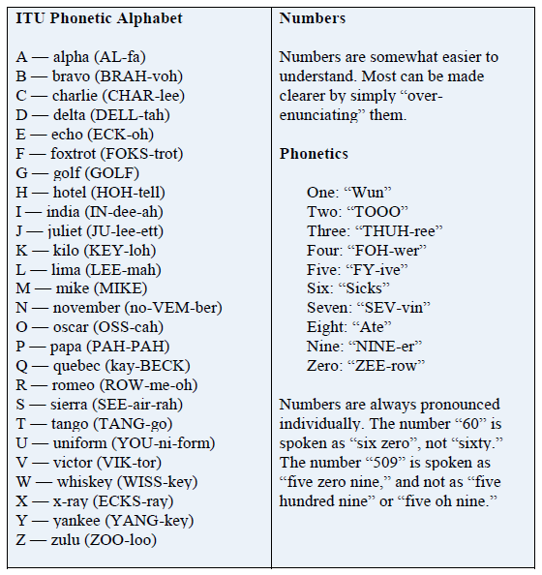
Phonetics & Prowords

Slide 26
Phonetics & Prowords
Prowords
Prowords, called “prosigns” when sent in Morse code or digital modes, are procedural terms with specific meanings (“pro” is short for “procedural”).
They are used to save time and ensure that everyone understands precisely what is being said.
Some prowords are used in general communication, others while sending and receiving formal messages.
The usage and meaning of some prowords in other services, such as police, fire, or military, may differ from Amateur Radio usage. are some prowords and prosigns in common usage in Amateur Radio communications:

Slide 27
Phonetics & Prowords

Slide 28
Phonetics & Prowords
ARMY STUDY GUIDE
PROWORDS
To keep voice transmission as short and clear as possible, radio operators use procedure words (PROWORDs) to take the place of long sentences.
The PROWORDs and their meanings are listed on the following pages.

Slide 29
Phonetics & Prowords

Slide 30
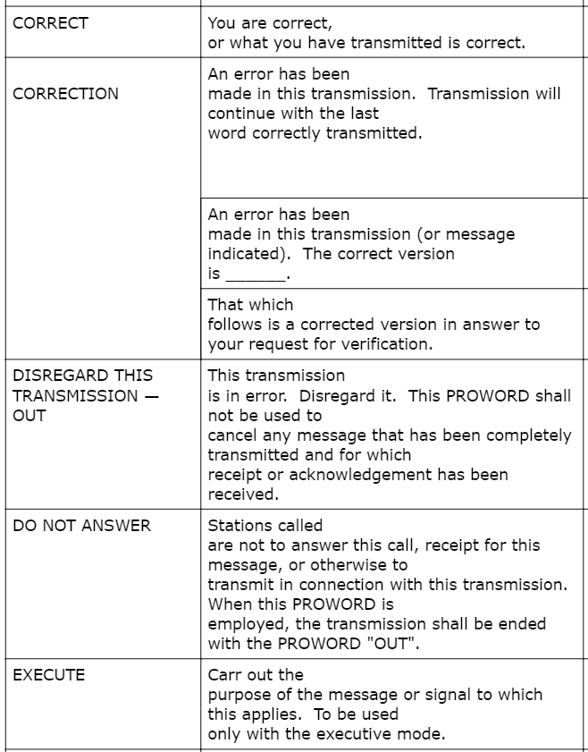
Phonetics & Prowords

Slide 31
Phonetics & Prowords

Slide 32
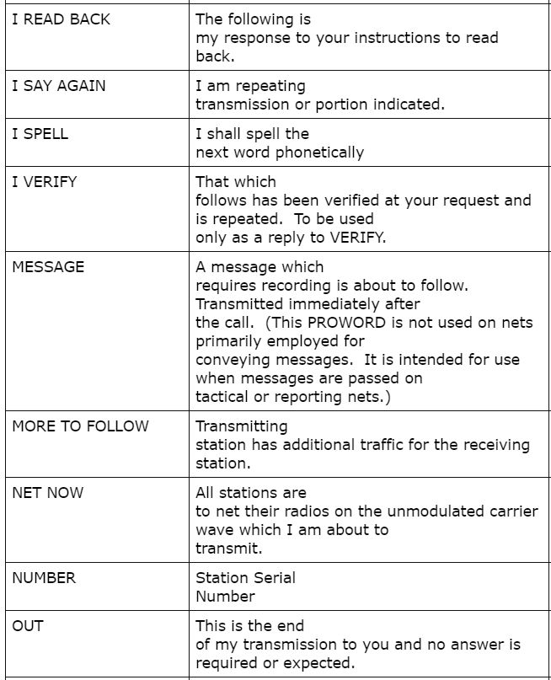
Phonetics & Prowords

Slide 33
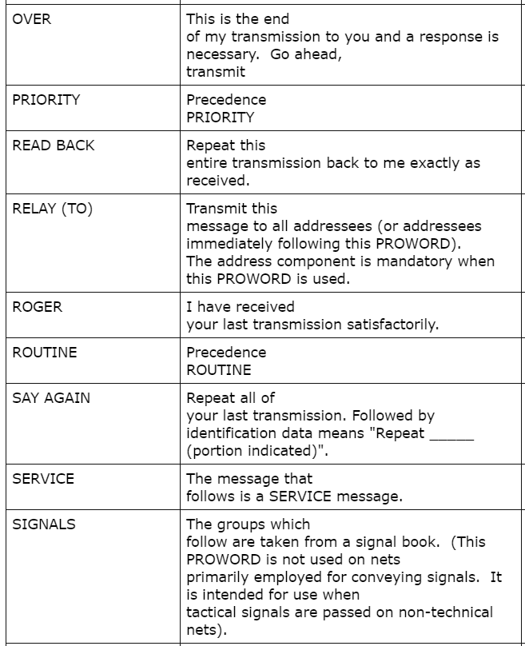
Phonetics & Prowords

Slide 34
Phonetics & Prowords

Slide 35
Phonetics & Prowords

Slide 36
Risk Management & Safety

Slide 37
Risk Management & Safety
VDF soldiers are required to respond to numerous types of domestic emergencies.
While operating at the scene of natural disasters involving hurricanes, tornados, floods, or operating at other types of incidents, VDF soldiers may come into contact with numerous hazards that can cause injury and/or death.
This training is intended to provide basic situational awareness to VDF soldiers to help them recognize these dangers and thereby minimize exposure to these hazards.
Notes:
When you are responding to an emergency on SAD, you may be exposed to numerous hazards that can cause injury or worse. Today we will discuss some of these hazards, the importance of situational awareness, and ways soldiers can minimize the risks to themselves and those around them.

Slide 38
Risk Management & Safety
RISK MANAGEMENT PROCESS
Step 1 - Identify the hazards
Step 2 - Assess the hazards
Step 3 - Develop Controls and make risk decision
Step 4 - Implement controls
Step 5 - Supervise and evaluate
Assess
Hazards
Develop
Controls
Identify
Hazards
Risk
Management
Process
Implement
Controls
Supervise
& Evaluate

Slide 39
Risk Management & Safety
RISK MANAGEMENT PRINCIPLES
Integrate risk management into mission
planning, preparation, and execution.
Make risk decisions at the appropriate level
in the chain-of-command.
3. Accept no unnecessary risk.

Slide 40
Risk Management & Safety
TERMS AND DEFINITIONS
RISK ASSESSMENT- Risk assessment is the
identification and assessment of hazards
(the first 2 steps of risk management process).
HAZARD- Any actual or potential condition that
can cause injury, illness, or death of personnel;
damage to or loss of equipment or property;
or mission degradation.

Slide 41
Risk Management & Safety
TERMS AND DEFINITIONS
RISK The probability of exposure to injury or loss from hazard. Risk level is expressed in terms of hazard probability and severity. Two kinds of risk:
- Tactical risk - Risk associated with hazards that exist because of the presence of the enemy or an adversary.
- Accident risk - Includes all operational risk considerations other than tactical risk, and can include activities associated with hazards concerning friendly personnel, equipment, readiness, and environmental conditions.

Slide 42
Risk Management & Safety
TERMS AND DEFINITIONS
PROBABILITY- The likelihood that an event will occur.
There are five degrees of probability:
Frequent Likely Occasional Seldom Unlikely
SEVERITY- The degree of injury, property damage, or other mission impairing factors.
There are four degrees of severity.
Catastrophic Critical Marginal Negligible

Slide 43
Risk Management & Safety
DETERMINE THE
DEGREE OF PROBABILITY
PROBABILITY - The likelihood that an event will occur. Determine what is the chance or likelihood of the event occurring? There are five degrees of probability:
- Frequent - Occurs often, continuously experienced.
- Likely - Occurs several times.
- Occasional - Occurs sporadically.
- Seldom - Remotely possible: could occur at some time.
- Unlikely -Can assume it will not occur, but not impossible.

Slide 44
Risk Management & Safety
DETERMINE THE
DEGREE OF SEVERITY
SEVERITY- The degree of injury, property damage, or other mission impairing factors. There are four degrees of severity.
Catastrophic - Loss of ability to accomplish the mission or mission failure. Death or permanent total disability, system loss, or major property damage.
Critical - Significantly degraded mission capability or unit readiness. Permanent partial disability, temporary total disability in excess of three months, major system damage, or significant property damage.
Marginal - Degraded mission capability or unit readiness. Minor injury, lost workday accident, minor system damage, and minor property damage.
Negligible - Little or no adverse impact on mission capability. First aid or minor medical treatment, minor system impairment.

Slide 45
Risk Management & Safety
TERMS AND DEFINITIONS
RISK LEVEL- Expressed in terms of hazard probability and severity. There are four levels of risk.
Extremely High Risk (E) - Loss of ability to accomplish the mission.
High (H) - Significantly degrades mission capabilities in terms of required mission standards.
Moderate (M) - Degrades mission capabilities in terms of required mission standards.
Low (L) – Little to no impact on accomplishment of mission.

Slide 46
Risk Management & Safety
TERMS AND DEFINITIONS
CONTROLS- Controls are actions taken to eliminate the hazard or reduce their risk. Controls may take many forms, but fall basically into three categories:
Educational Controls - These controls are based on the knowledge and skills of the units and soldiers.
Physical Controls - These controls may take the form of barriers and guards or signs to warn individuals and units that a hazard exists.
Avoidance - The control is applied by taking positive action to eliminate the presence of an identified hazard.

Slide 47
TERMS AND DEFINITIONS
RESIDUAL RISK- Residual risk is the level of risk remaining after controls have been selected for hazards (Controls are identified and selected until residual risk is at an acceptable level or it cannot be practically reduced further).
RISK DECISION- The decision whether to accept or not to accept the level of residual risk

Slide 48
RISK MANAGEMENT WORKSHEET
B. Date/Time Group
Begin:
End:
A. Mission or Task
C. Date Prepared:
D. Prepared By: (Rank, Last Name, Duty Position)
E. Task
F. Identify
Hazards
G. Assess
Hazards
H. Develop
Controls
I. Residual
Risk
J. Implement
Controls
(How To)
K. Overall risk level after controls are implemented (circle one)
LOW (L) MODERATE (M) HIGH (H) EXTREMELY HIGH (E)

Slide 49
INDIVIDUAL HAZARD RISK ASSESSMENT MATRIX
HAZARD PROBABILITY
S
E
V
E
R
I
T
Y
Frequent
Likely
Occasional
Seldom
Unlikely
Catastrophic
E
E
H
H
M
Critical
E
H
H
M
L
Marginal
H
M
M
L
L
Negligible
M
L
L
L
L
NOTE: The matrix can be a useful tool, but is not a replacement
for a detailed, careful analysis.
RISK LEVELS
E (Extremely High Risk) - Loss of ability to accomplish the mission.
H (High Risk) – Significantly degrades msn capabilities in terms of required msn stds.
M (Moderate Risk) - Degrades msn capabilities in terms of required mission stds.
L (Low Risk) - Little or no impact on accomplishment of the mission.

Slide 50
Risk Management & Safety
1. Before any erection of an antenna, SURVEY the area for hazards, especially
Power lines
Dead trees or any other hazards
Potential storm activity.
Power: Last ON, first OFF.
Connect antennas, grounds, ancillaries and after all that, connect DC power.
When commo activities cease, DC power is disconnected FIRST.
NO FRIED RADIOS!!!!!

Slide 51
Questions?

